Slide 1


Introduction
EMPOWER YOUR LEARNING WITH
DEPI LMS
Transforming the Way, You Manage Your Learning
Learning Management System for Digital Egypt’s Pioneers Initiative. Facilitating the communication between initiative parties and managing the content of the initiative throughout the round.
www.depi.gov.eg

Slide 2


Solution
MANAGING LEARNING CAN BE OVERWHELMING
Our solution?
DEPI LMS
We are trying to solve the problem of miss-communication between Ministry of Communication and Information Technology (MCIT ) and training companies up to the individual student. This miss-communication leads to inconsistency and frustrating for students.
New Generations
We are trying to build something useful for those who will come after us.

Slide 3

Features
Registration and Application Management
INTRODUCE THE APPS
Main
Tracking System
Features
Announcements Management
We have developed a set of features that we found as areas of pain to the students. There are other features but those are our main.
Material Management
Attendance Management and Reporting
Session Management

Slide 4
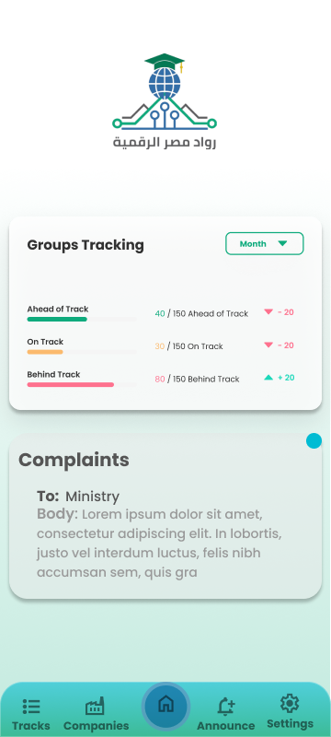
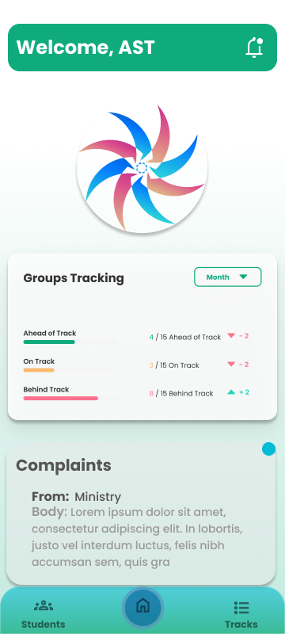
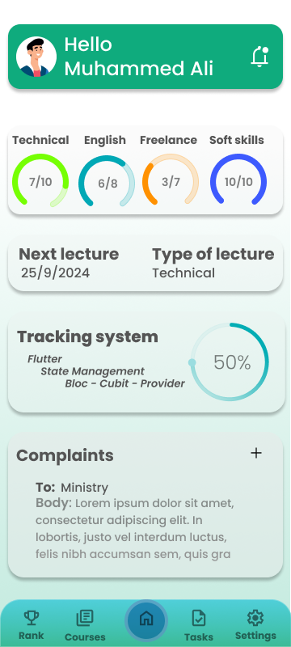
NAVIGATE THROUGH YOUR LEARNING EXPERIENCE EFFORTLESSLY
With Our Friendly
User Interface

Slide 5

Registration and Applications Management
Accepting New Users and applicants for future Pioneers.
Ensuring Your
It used to take students a lot of time to fulfill the process of applying to the initiative. With various data needed and potential edits.
Data persistence
That’s why we used persistent storage in our system which is a mix of local storage and Firebase. where data needs to remain consistent and accessible, even in the event of crashes or shutdowns.

Slide 6
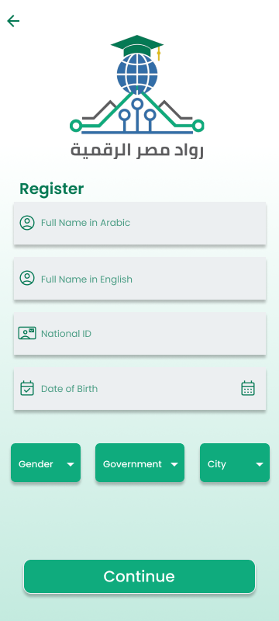
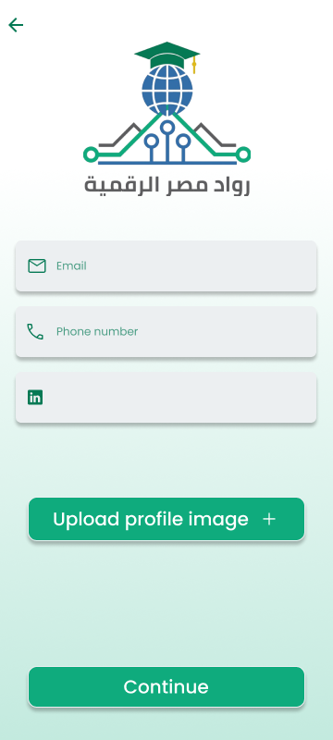
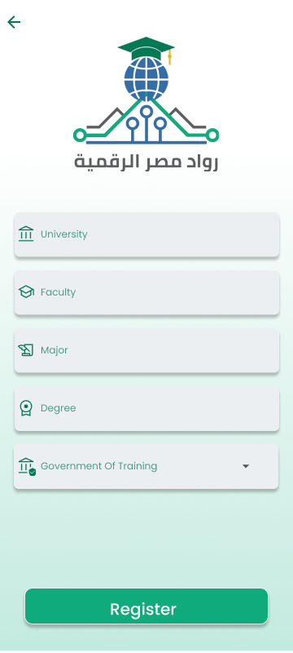


Slide 7



Tracking System
MAKE ACCURATE DECISIONS WITH
Real-time Tracking of
Insights and Progress
By Using this tracking system. We are notifying the MICT of each group’s progress so, it should have an active eye on training companies' commitment to time-line
Some groups and some students faced challenges where the training company has gone behind specified time-line which resulted the majority of the curriculum to be self-studied.

Slide 8
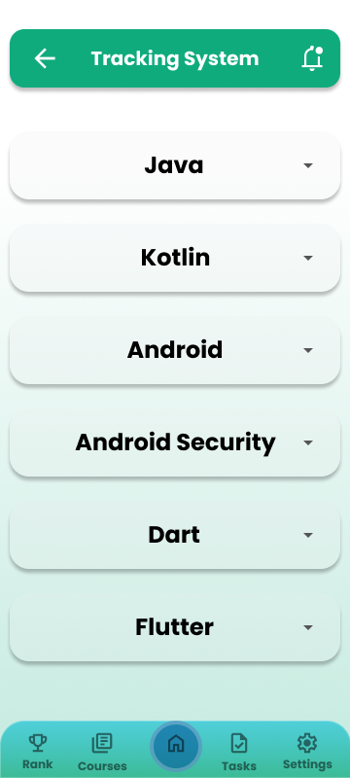
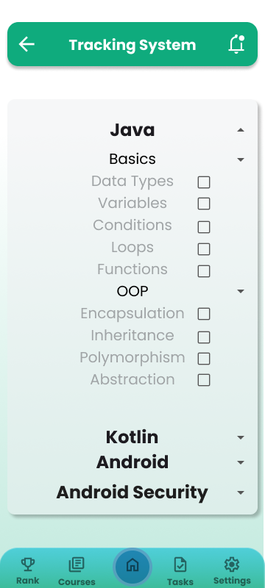
Tracking on student’s side

Slide 9
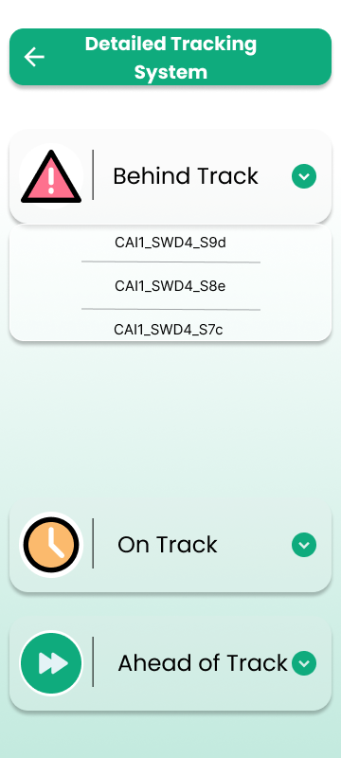
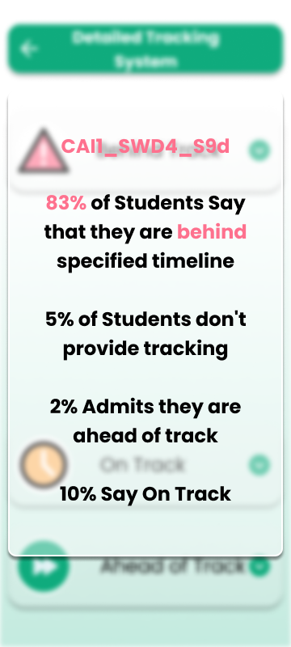
Tracking on Company’s side

Slide 10
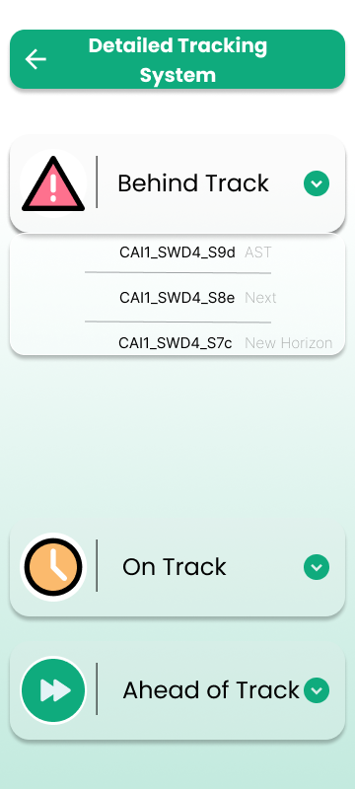
Tracking on Ministry’s side

Slide 11

Announcements
EASILY KEEP EVERYONE CONNECTED THROUGH
ANNOUNCEMNT
Management
Previously student used to get frustrated by the river of notifications and emails sent by DEPI Management throughout the initiative period specially at the very beginning.
We decided to keep all important announcements at one place to facilitate reaching it for the three parties

Slide 12
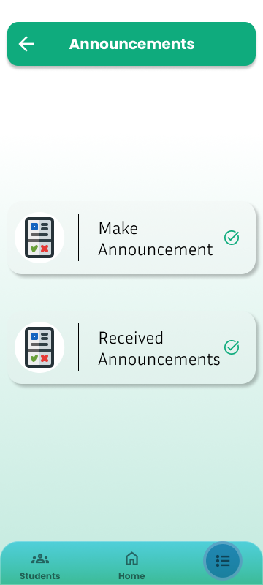
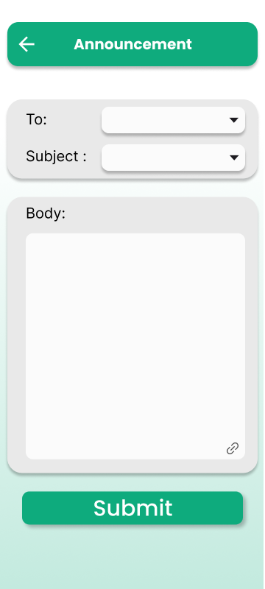
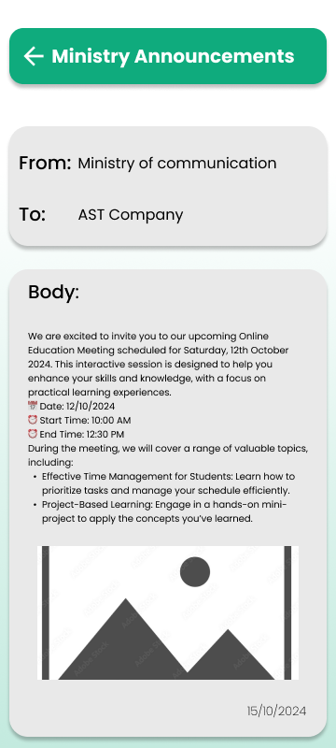
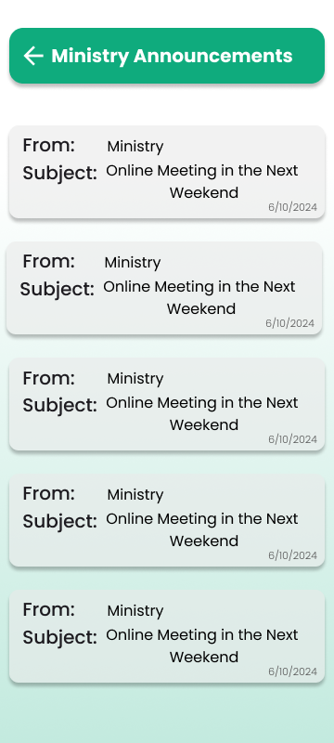
Announcements on Company’s side

Slide 13
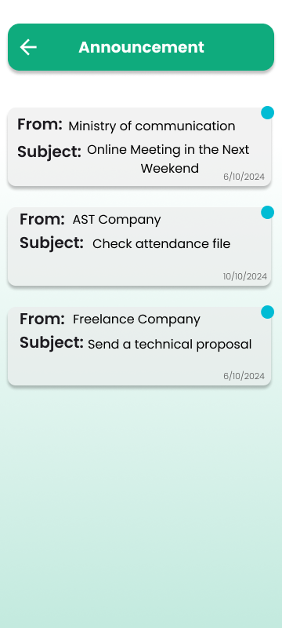
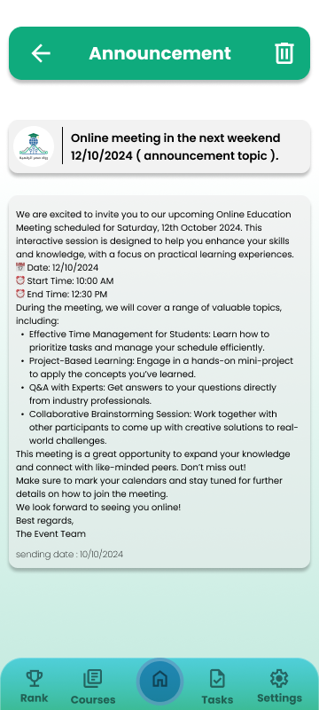
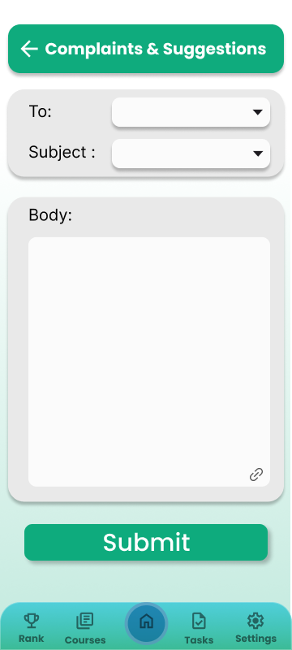
Announcements & Complaints on Student’s side

Slide 14


Material Management
SYNC SEAMLESSLY WITH YOUR STUDENTS FOR
Effective
During the initiative students needed to access tens of links to get their slides, videos, PDFs , etc.
Material Management
We Tried to address this problem by collecting all the materials in one place including study material and assignments material.
This facilitates material adding and editing to the company’s side and material fetching and organizing for students.

Slide 15
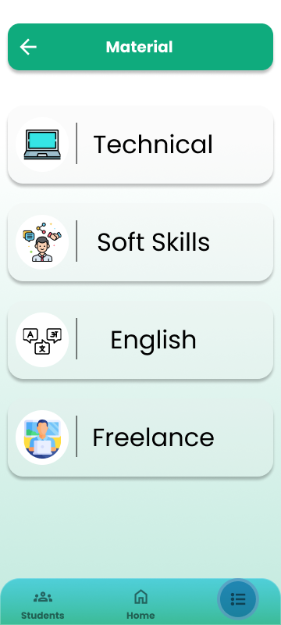
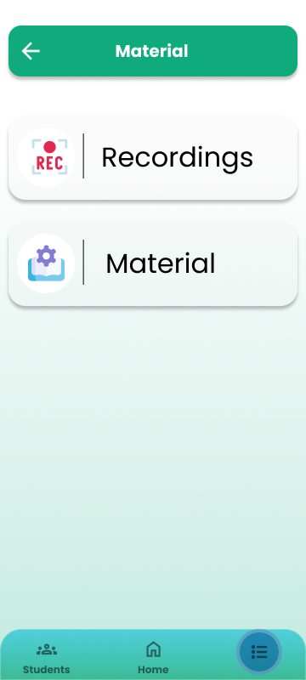
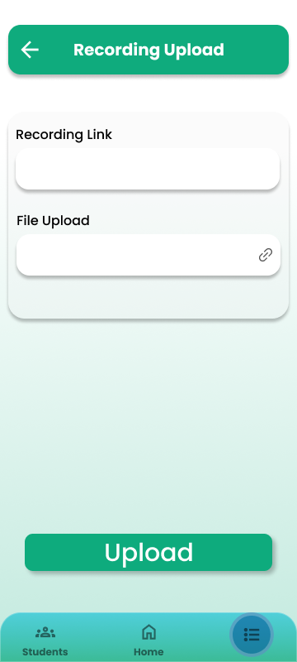
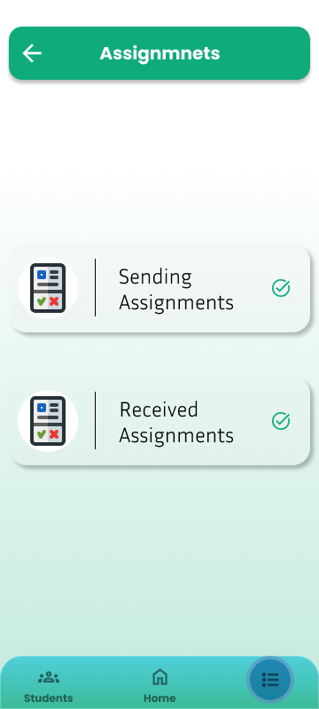
Material Management Company’s side

Slide 16
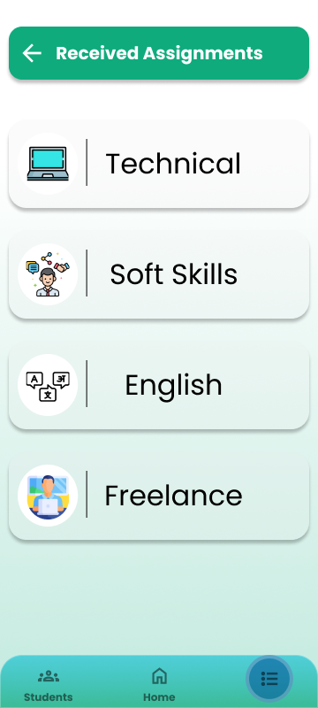
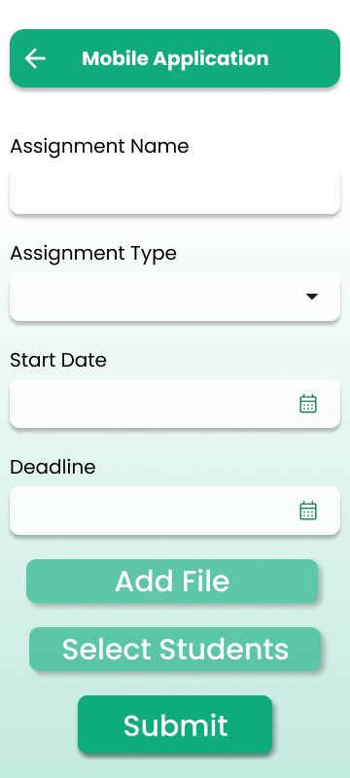
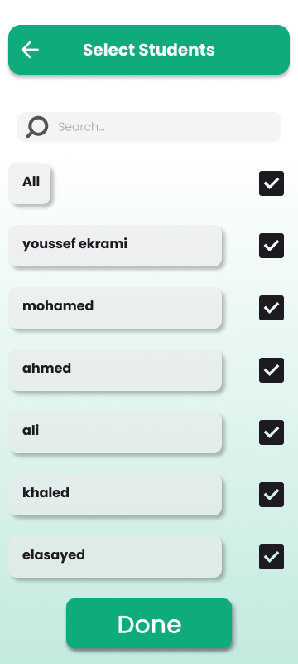
Assignments Management Company’s side

Slide 17
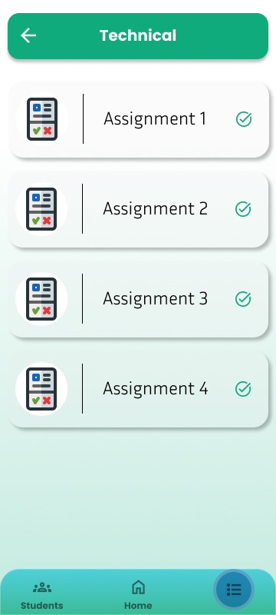
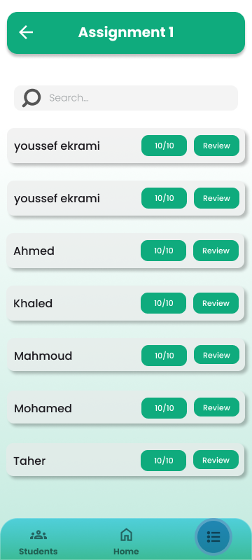
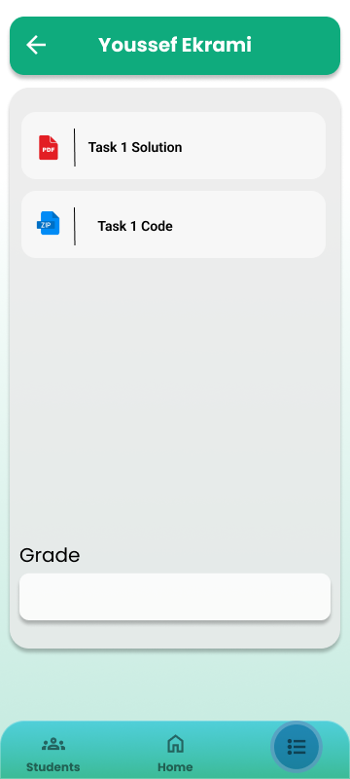
Assignments Management Company’s side

Slide 18
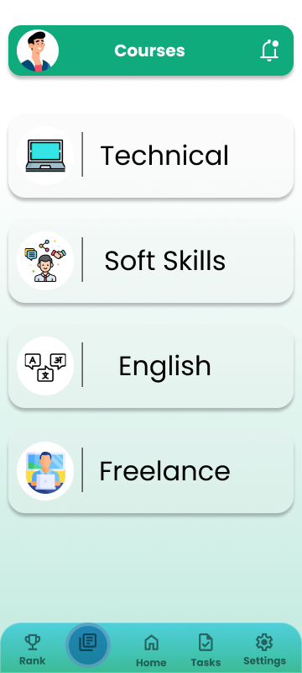
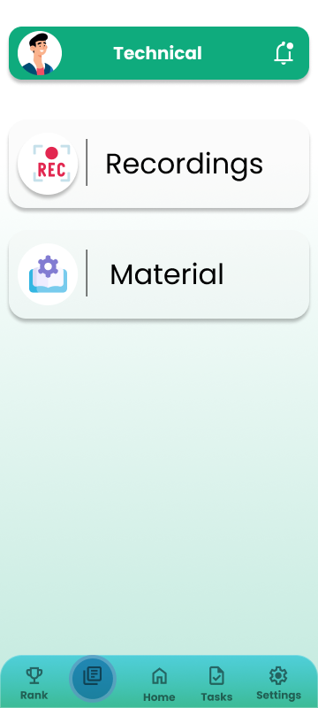
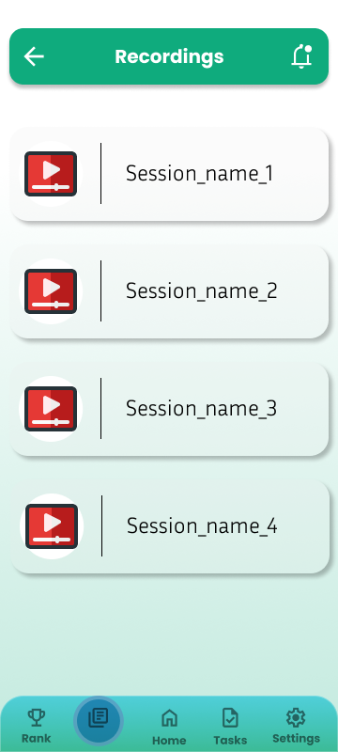
Material Management Student’s side

Slide 19
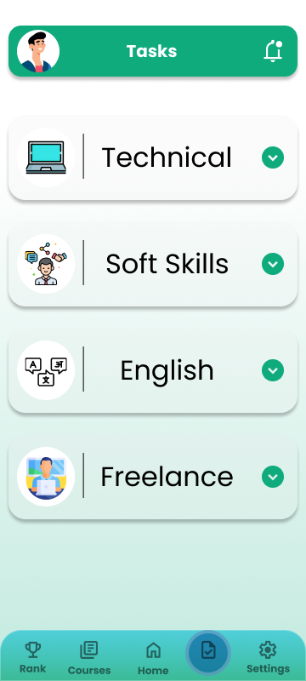
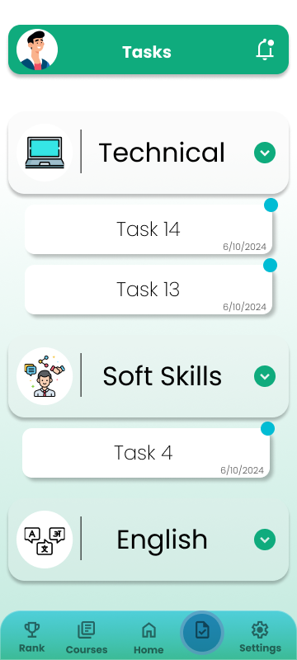
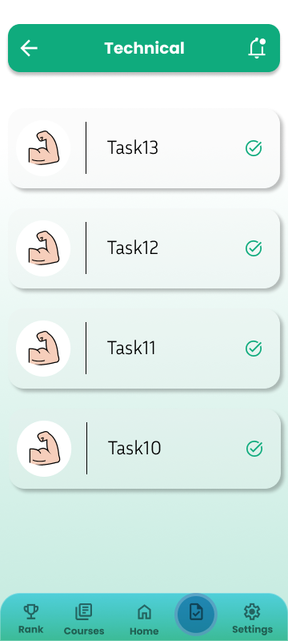
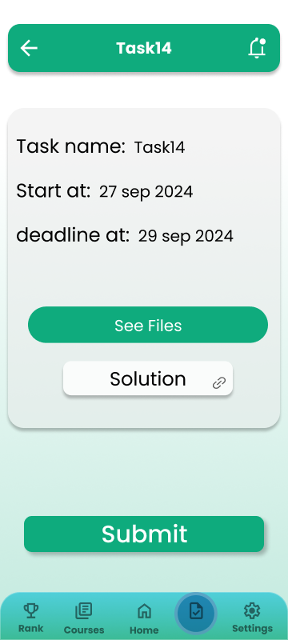
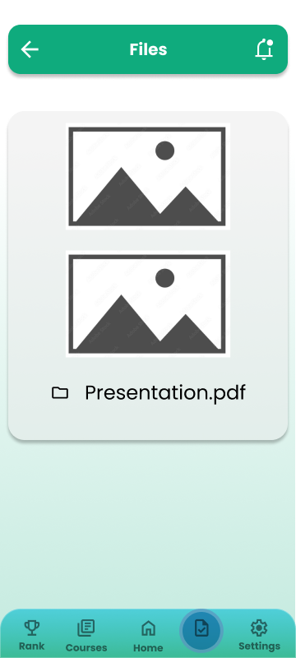
Assignments Management Student’s side

Slide 20
Attendance & Reporting
Keep an eye on your students’ attendance by
Tracking sheets &
Instead of using a paper in a physical meeting or calling out students’ names in a virtual meeting.
Attendance
We implemented attendance system which could be assigned manually by the moderator or automatically by the application to monitor students’ attendance. Then, we can use this while reporting final grades.

Slide 21
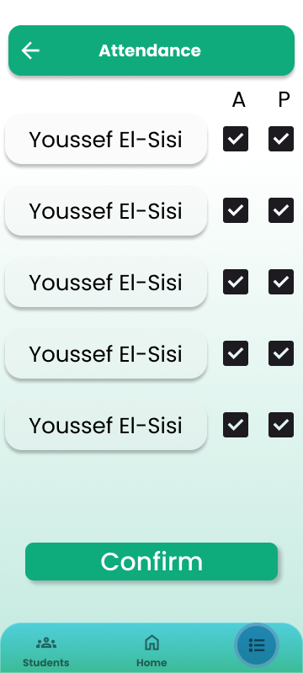
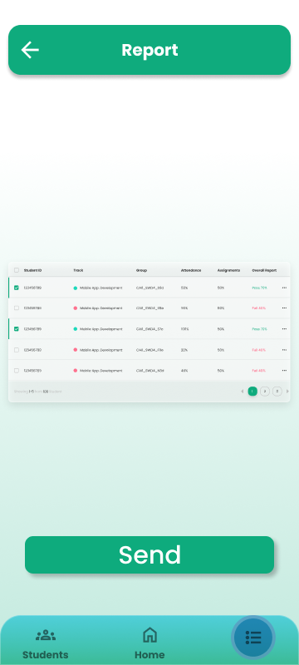
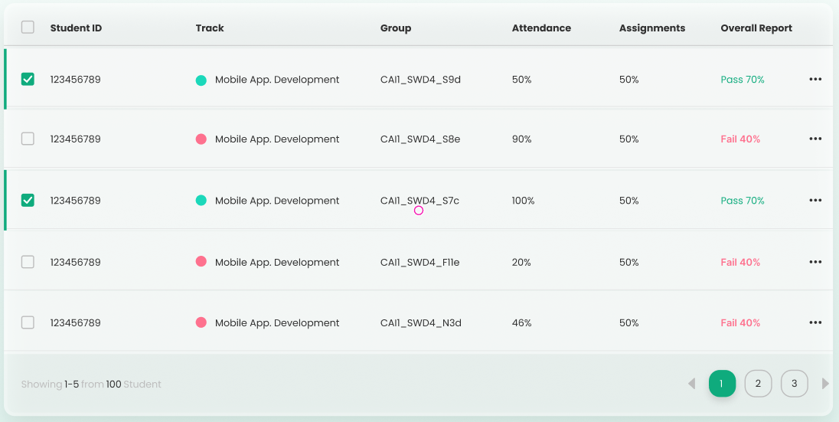
Attendance Management & Reporting

Slide 22
Tracking System
MANAGE YOUR RESOURCES AND PLACES
By actively updating
Session Management
We made a section to answer all of these questions which is updated frequently by the moderator of the training company.
Specially at the beginning of the initiative, students used to ask frequently about the place of the training, how to get there, the time of the session, the name of the session, etc.

Slide 23
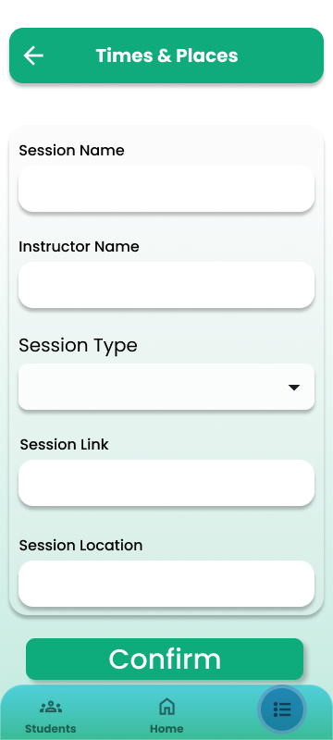
Session Management

Slide 24
Out Team
Who are we?
Meet our team
Wafaa
Yousry
Muhammed Abdullah
Ekrami
Our workaholic member and dead-line achiever. Who constantly work till it’s done.
Team leader and the backbone of our team. Assigning and collecting tasks and refactoring our code.
The attentive, bugs catcher and product owner of our application. He always puts himself in the shoe of the user.
El-Sisi
Aalaa
Abdullah
Ahmed Abdeltwab
The presenter, our talking tongue. The man of communication and relations.
The logical brain, artist of converting designs to implementations.
System analyst and requirement gatherer.

Slide 25
The End
Thank
You

